Slide 1


ANNA UNIVERSITY, CHENNAI – 600 025
R.M.K. COLLEGE OF ENGINEERING AND TECHNOLOGY DEPARTMENT OF ELECTRONICS AND COMMUNICATION ENGINEERING
B.E – PRODUCT DEVELOPMENT LAB- First Review - DATE: 28-02-26
PranaRakshak- Smart Pollution Monitoring & Safety System
SDG 3 – Good Health and Well-Being
ARPIT MISHRA S - 111624104007
HIMA ADHITYA B - 111624104031
JAGANS - 111624104034
Under the Guidance of
Dr.S.MUTHUMANICKAM
Professor
DEPARTMENT OF ECE

Slide 2
CONTENTS
OBJECTIVE
INTRODUCTION
LITERATURE REVIEW
PROBLEM STATEMENT
PROPOSED WORK
FLOW DIAGRAM
BLOCK DIAGRAM
CONCLUSION
REFERENCES
WORKPLAN

Slide 3
OBJECTIVES
To continuously monitor industrial air quality parameters such as toxic gases, temperature, and humidity in real time.
To detect early signs of fire and smoke using an AI-based vision system for faster response.
To automatically generate emergency alerts to industry management, government authorities, hospitals, and emergency services.
To develop a custom web-based dashboard for real-time data visualization and remote monitoring.
To reduce industrial accidents, environmental damage, and human fatalities through intelligent and automated safety mechanisms.

Slide 4
INTRODUCTION
Industrial safety becomes critical for small industries which operate in remote areas and semi-urban regions because they lack access to advanced monitoring systems and emergency response capabilities. The current fire and pollution detection systems operate as expensive solutions which only respond to emergencies without automatic alert systems, which results in emergency response delays during incidents like fire outbreaks and toxic gas leaks. The delays which occur during this process lead to three different types of damage which include human fatalities and environmental destruction and economic damage.
The project presents an affordable safety system which uses Internet of Things technology to monitor environmental conditions and employs artificial intelligence for fire detection while displaying information through a Flask web application. The system detects hazards at an early stage and sends automatic notifications to government offices and medical facilities and ambulance services, which leads to faster emergency response times and decreased deaths in industrial environments located far from urban centers.

Slide 5
Literature Review
SI.No | Title of the Paper | Year of Publication | Methodology | Pros | Cons
1 | IoT-Based Industrial Air Pollution Monitoring System | 2022 | Used MQ135 gas sensor, DHT11 sensor, and Arduino/ESP8266 for real-time air quality monitoring. Data transmitted to cloud platform for visualization and alert generation. | Low-cost IoT implementation Real-time monitoring Cloud-based visualization
2 | Real-Time IoT and AI-Based Air Quality Monitoring in Industrial Environments | 2023 | Integrated IoT sensors with machine learning models to analyze pollution patterns and detect hazardous conditions. Data stored and processed on cloud servers. | AI-based analysis Improved prediction accuracy Remote monitoring capability
3 | Vision-Based Fire and Smoke Detection Using Deep Learninga |  | Used Convolutional Neural Networks (CNN) to process real-time camera images for early fire and smoke detection.

Slide 6
PROBLEM STATEMENT
Small-scale industries in remote and semi-urban areas lack fast safety monitoring and emergency support.
Traditional fire and pollution detection systems are expensive and slow to respond.
Existing systems do not provide automatic alert notifications to authorities.
Communication delays occur between industries, government officials, hospitals, and emergency services.
Late detection and response lead to environmental damage, financial loss, and human casualties.

Slide 7
PROPOSED WORK
This work proposes a low-cost, intelligent industrial safety and emergency response system designed for small-scale industries located in remote and semi-urban regions. The system integrates IoT-based environmental sensors for real-time pollution and gas monitoring with an AI-based vision module for early fire detection. A custom Flask-based web dashboard is developed to provide continuous monitoring, data visualization, and alert management.
Upon detecting hazardous conditions such as fire, toxic gas leakage, or abnormal pollution levels, the system automatically triggers location-based emergency notifications to government officials, nearby hospitals, and ambulance services. The primary objective is to reduce detection and response time, thereby minimizing human casualties, environmental damage, and economic loss in remote industrial settings.

Slide 8
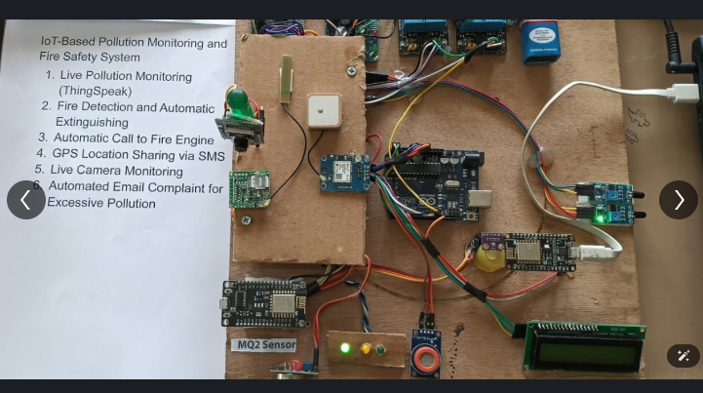
HARDWARE IMPLEMENTATION

Slide 9
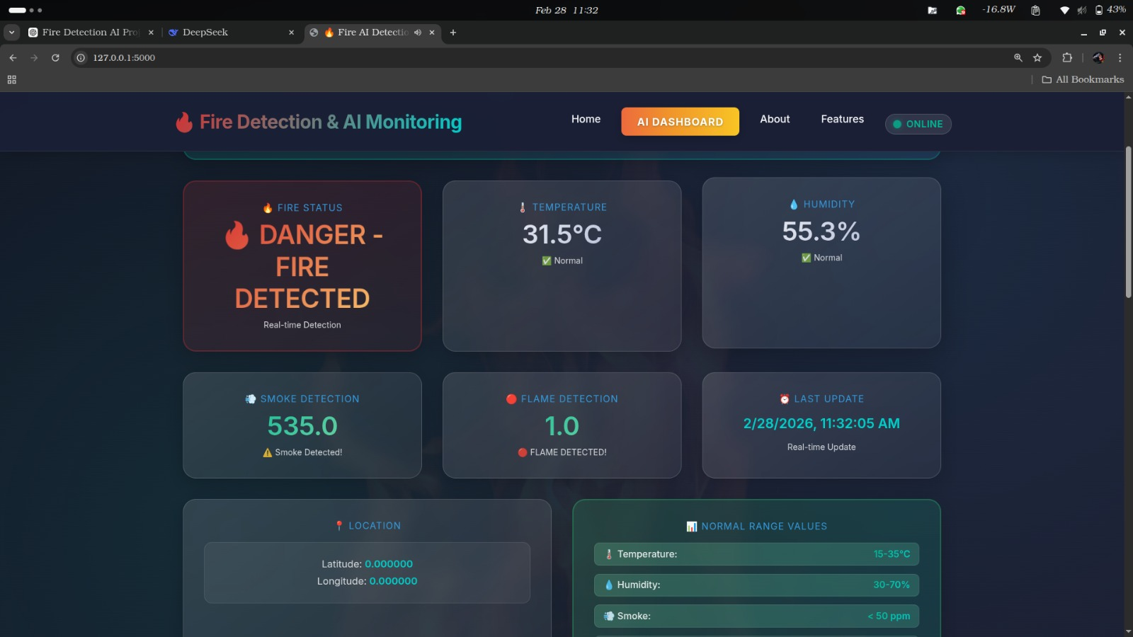
SOFTWARE IMPLEMENTATION

Slide 10
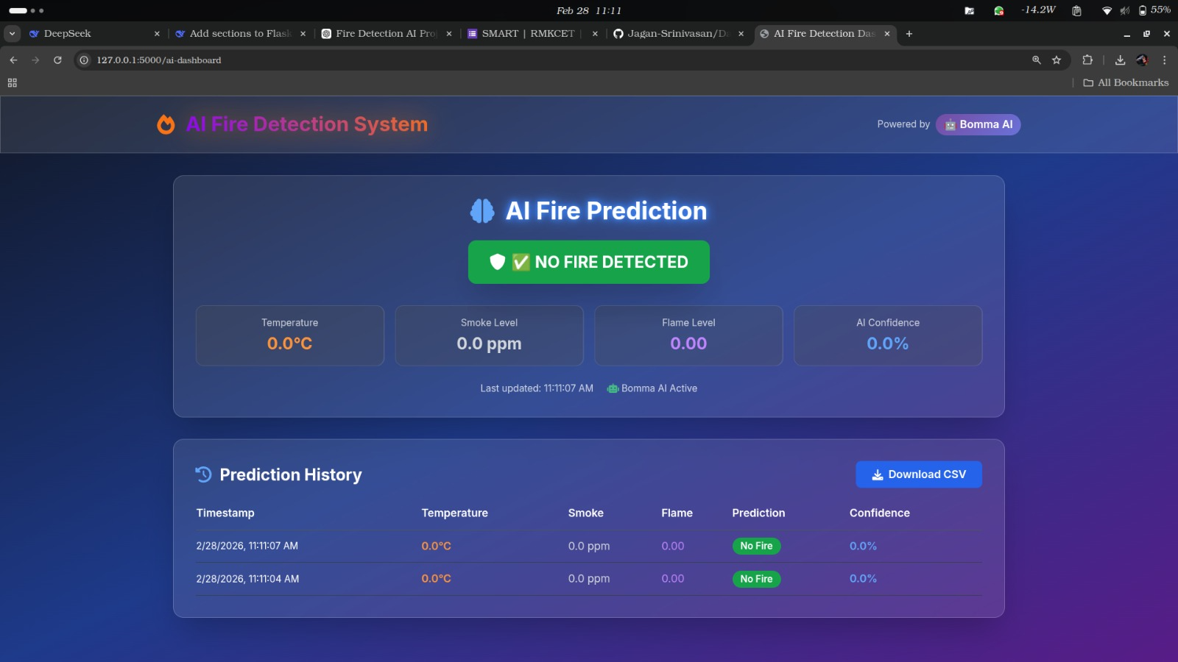


Slide 11
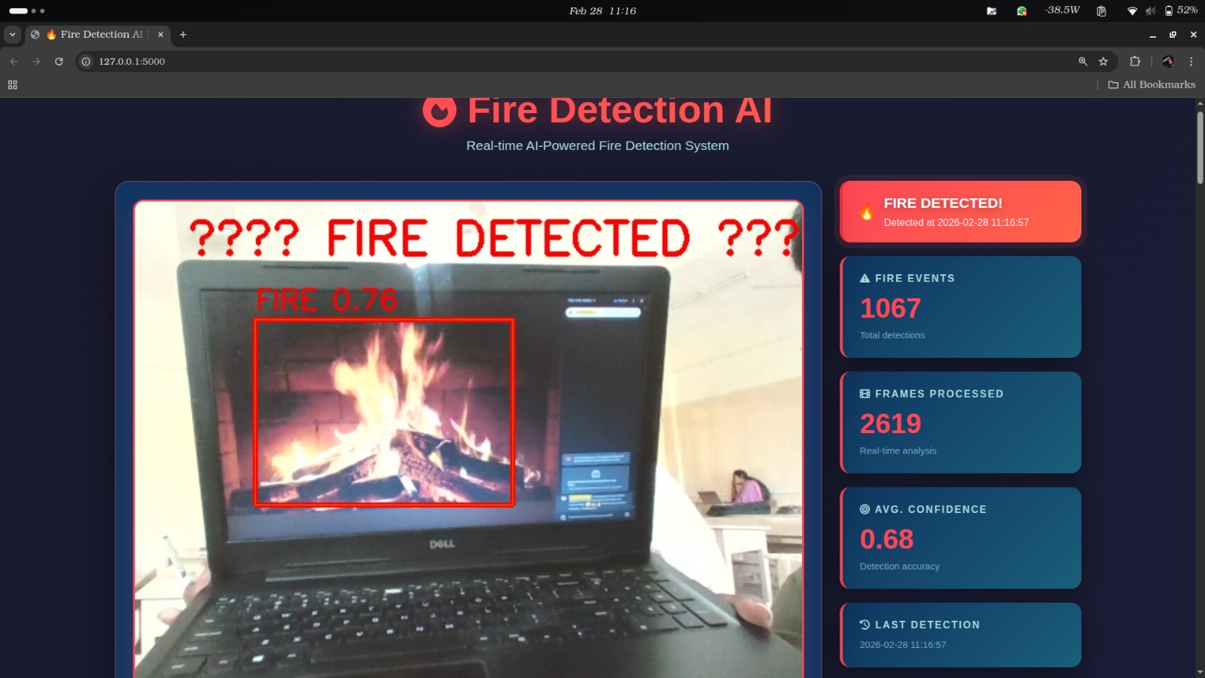

Slide 12
Simulation/Equipments/Components
Arduino Microcontroller
ESP8266 Microcontroller
MQ135 Gas Sensor& DHT11 Sensor
Flame Sensor
GPS Module
GSM Module
Arduino IDE
Relay Module
Flask Web Framework(Custom Website)
Power supply units

Slide 13
FLOW DIAGRAM

Slide 14
BLOCK DIAGRAM

Slide 15
CONCLUSION

Slide 16
REFERENCES
M. Singh et al., “Real-time IoT-powered AI system for monitoring and forecasting of air pollution in industrial environment,” Ecotoxicology and Environmental Safety, Vol. 283, 116856, pp. 1–14, 2024.
Chirag Reddy Valagulam et al., “Monitoring of Cloud-based Air Quality using NodeMCU,” IJRASET, 2023, pp. 1–10.
Laura García et al., “Smart Air Quality Monitoring IoT-Based Infrastructure for Industrial Environments,” Sensors, Vol. 22(23), 9221, pp. 1–20, 2022.
Keerthi J., Sneha, Pavithra R., & Shashikala, “IoT Based Industrial Pollution Monitoring System,” IJPPC, Vol. 02, Issue 02, pp. 1–8, 2024.

Slide 17
WORK PLAN
Activity/Time Period | Dec | Jan (1-15) | Jan (16-31) | Feb (1-15) | Feb (16-28) | Mar (1-5) | Mar (5-10)
Literature Survey
Collecting components
Study of CapsNet Algorithm and Python
Connecting with software
Debugging the program
Getting desired output
Preparation and Submission of the final report

Slide 18
THANK YOU

